Slide 1
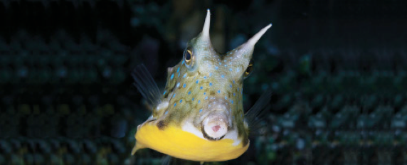
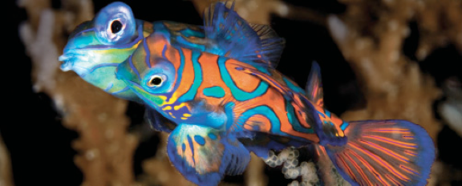
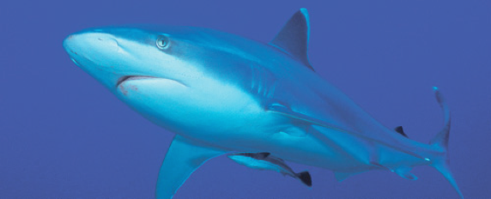
Lesson 9
Taxonomy III
Ichthyology
Shanghai Ocean University
Fall, 2020

Slide 2
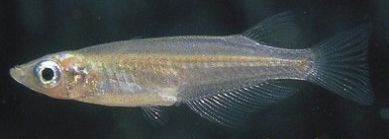
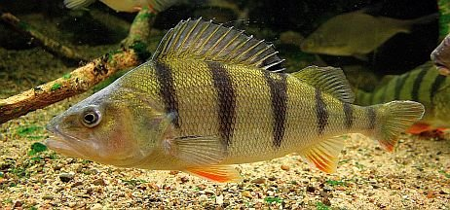
Teleosts III – Silversides to
Perches

Slide 3
Intro
Most fishes (14,800 species in 267 families) belong to the superorder Acanthopterygii and have highly protrusible jaws, a complex pharyngeal apparatus, two dorsal fins, and spines in the first dorsal, anal, and pelvic fins.
Three series are recognized, the Mugilomorpha, Atherinomorpha, and Percomorpha.
Mugilomorph mullets are marine and freshwater fishes with unconnected pectoral and pelvic girdles.
Atherinomorphs (silversides, needlefishes, flyingfishes, halfbeaks, killifishes, and livebearers) are shallow water, marine or freshwater fishes that live near the surface and have a unique jaw protrusion mechanism.

Slide 4
孙若凌
  List the common features of the superorder Acanthopterygii and give exemplary species

Slide 5
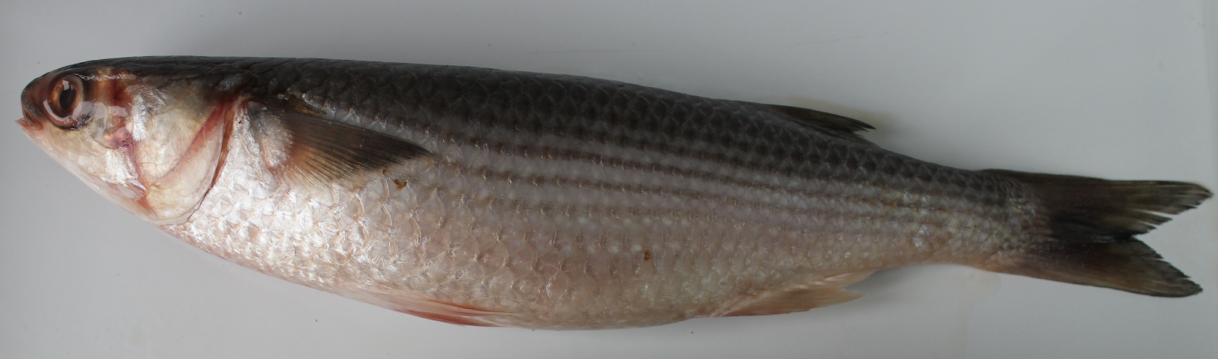
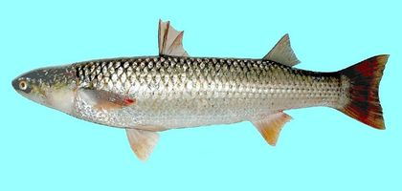
Mugiliformes
Mugil cephalus 鲻；Liza haematocheilus 鮻￼

Slide 6
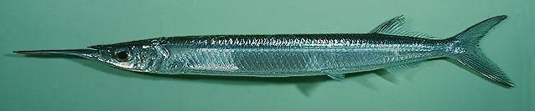
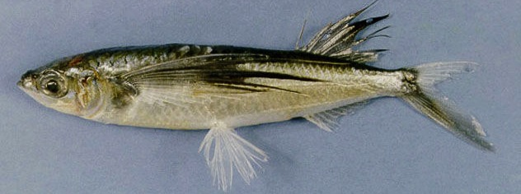
Atherinimorpha
Cyprinodontiformes Oryzias latipes 青鳉
Beloniformes Hemirhamphus georgii 乔氏鱵；Cypselurus oxycephalus 尖头燕鳐鱼

Slide 7
Percomorphs
The remaining nine orders are percomorphs. Stephanoberyciforms (whalefishes) and beryciforms (flashlight fishes, roughies, squirrelfishes) live in the moderate to deep sea, except for the reef-dwelling squirrelfishes; most are nocturnal.
Gasterosteiforms are small fishes with dermal armor plates, small mouths, and unorthodox propulsion.
Pipefish and seahorse males become pregnant, carrying developing embryos in a ventral pouch.
Scorpaeniforms are mostly marine, benthic fishes, except for freshwater cottid sculpins; many have head spines and venomous fin spines (e.g., turkeyfishes, stonefishes, scorpionfishes).

Slide 8
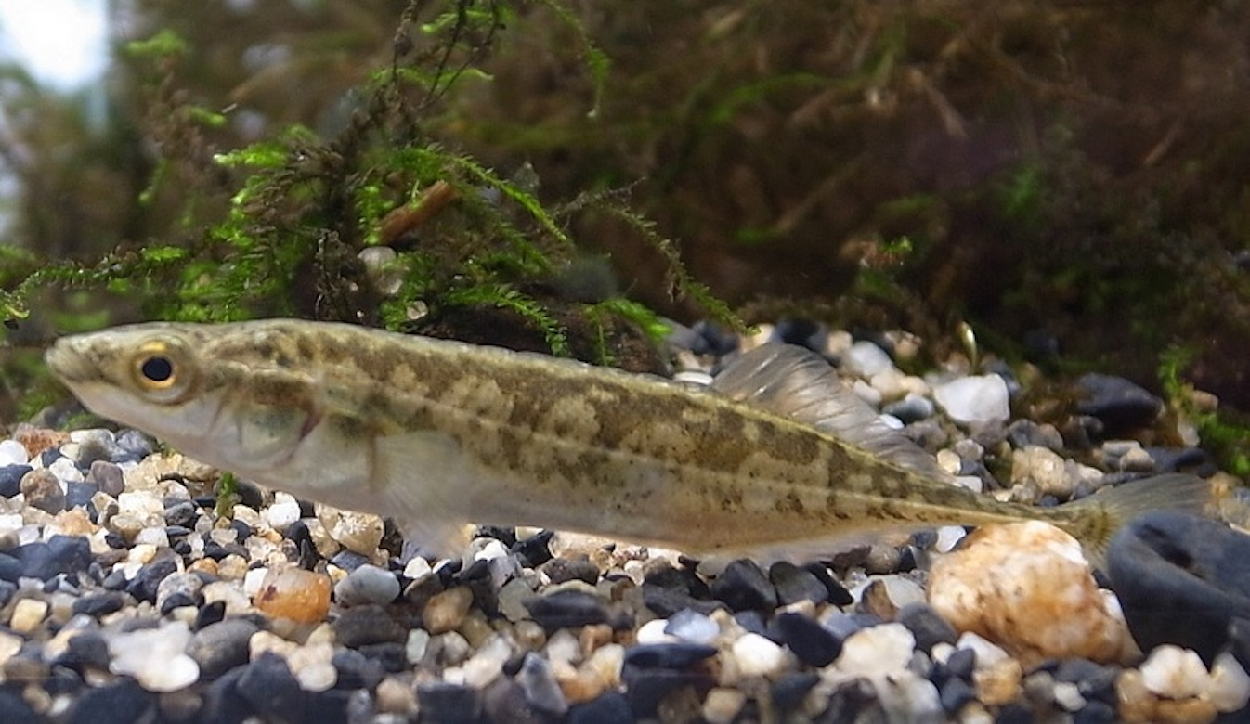
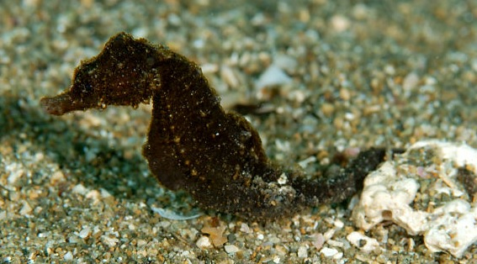
Gasterosteiformes
Pungitius sinensis 中华多刺鱼 (stickleback)；
Hippocampus japonicus 日本海马 (sea horse)

Slide 9
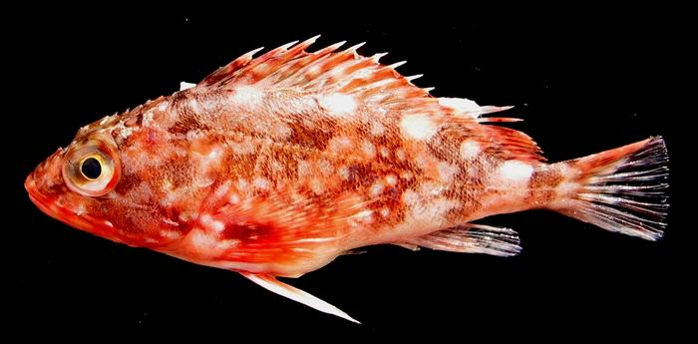
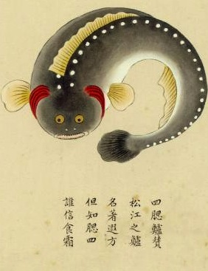
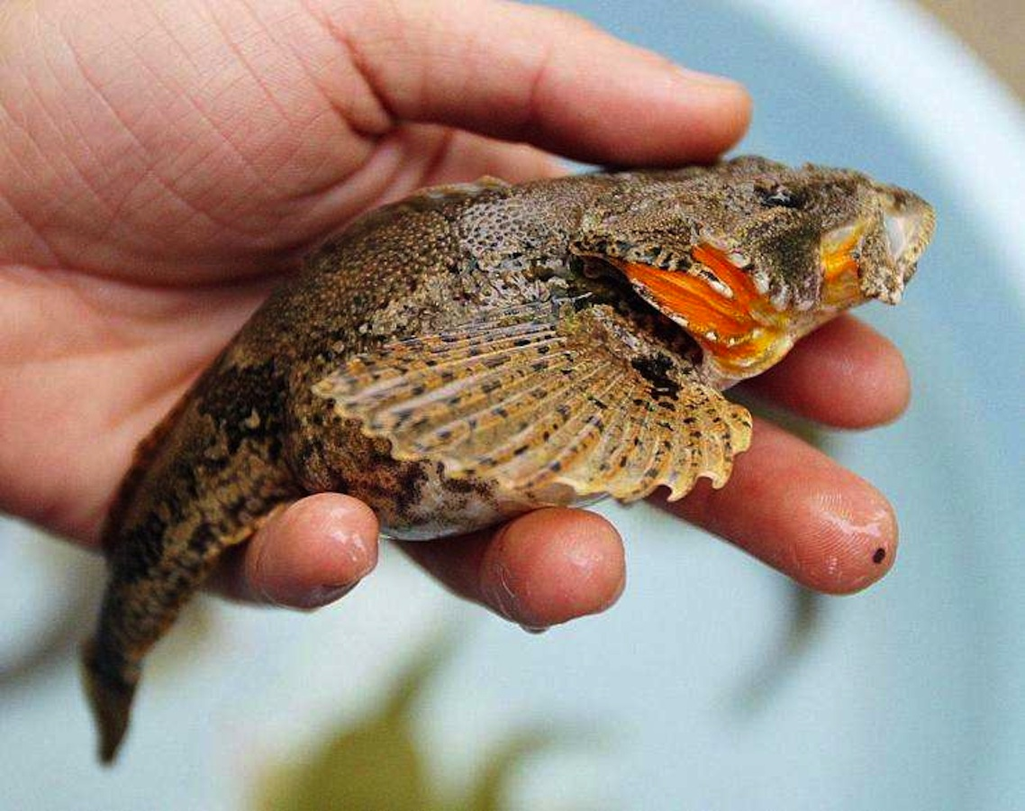
Scorpaeniforms (sculpins)
-Benthic (bottom dwelling); no swimbladder
-Large head w/spines on it; large eyes
-Compressed body
Sebastiscus marmoratus
Trachidermus fasciatus

Slide 10
Perciformes
The largest percomorph order is the Perciformes, with 160 families and 10,000 species, including most marine and freshwater fishes of littoral zones.
Perciforms have abdominal pelvic fins, lateral pectoral fins, and fewer than 18 caudal rays. Basal families are in the suborder Percoidei (78 families, 3176 species) including snooks, temperate basses, and the diverse seabasses.
Centrarchid sunfishes and percids (darters, perches, pikeperches) are important freshwater percoids of North America.
Other percoids include predatory carangoids, such as carangid jacks and pompanos, Cobia, dolphinfishes, and the sharksucking remoras.
Heavy-bodied, tropical, benthic, predatory families (snappers, sparoids) as well as fishes with barbels or feelers (croakers, threadfins, goatfishes) are placed here.
Other percoid families include archerfishes that shoot insects out of overhanging vegetation and the colorful coral reef butterflyfishes and angelfishes.

Slide 11
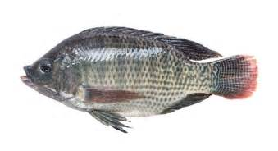
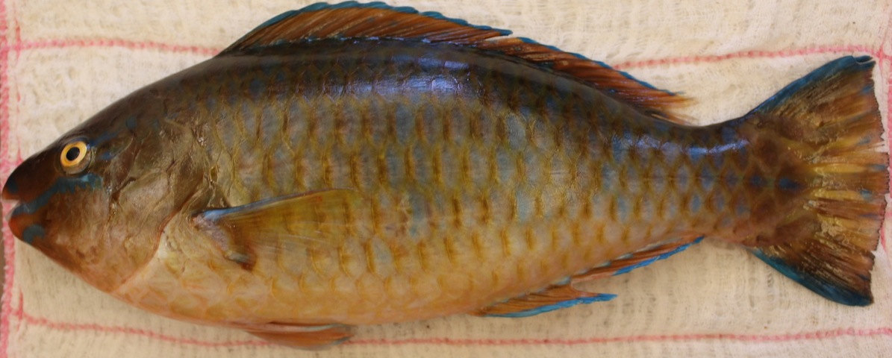
Labroidei
The suborder Labroidei has several speciose families. Cichlids are primarily freshwater fishes that have undergone explosive speciation, forming species flocks in Central African lakes.
Other labroid families are the primarily tropical damselfishes, wrasses, and parrotfishes, and the temperate surfperches and odacids.
Tilapia
Parrotfish

Slide 12
Cichlidae
祝晓璇
  Describe the family Cichlidae, including taxonomy, distribution, ecology, importance, etc.

Slide 13
Gobioidei (now Gobiiformes)
李佳蔚
  Describe the superfamily Gobioidei (now Gobiiformes), including taxonomy, distribution, ecology, importance, etc.

Slide 14
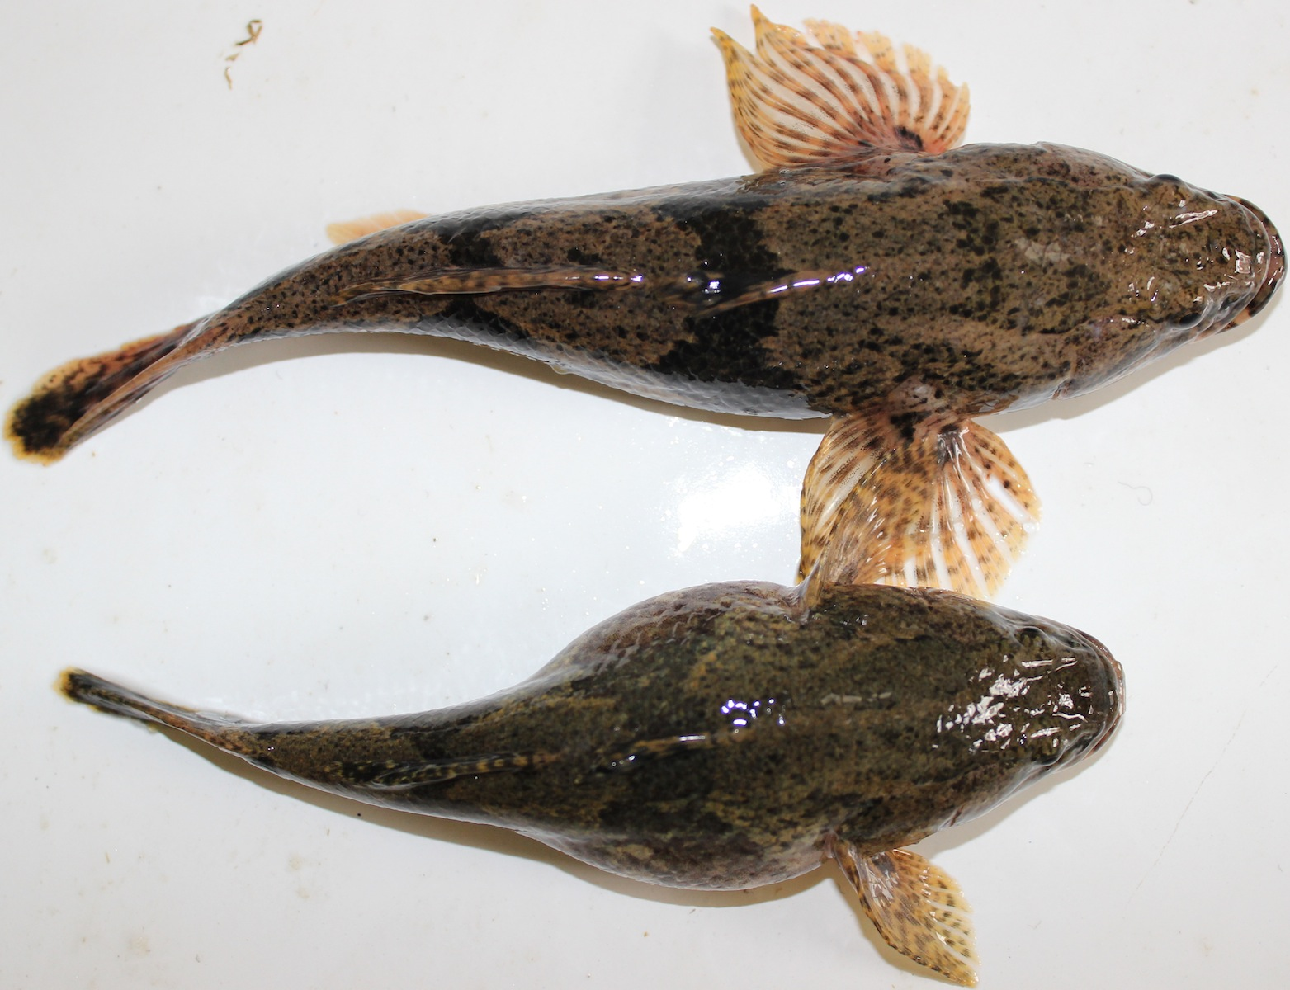
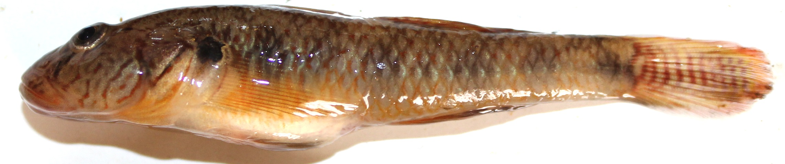
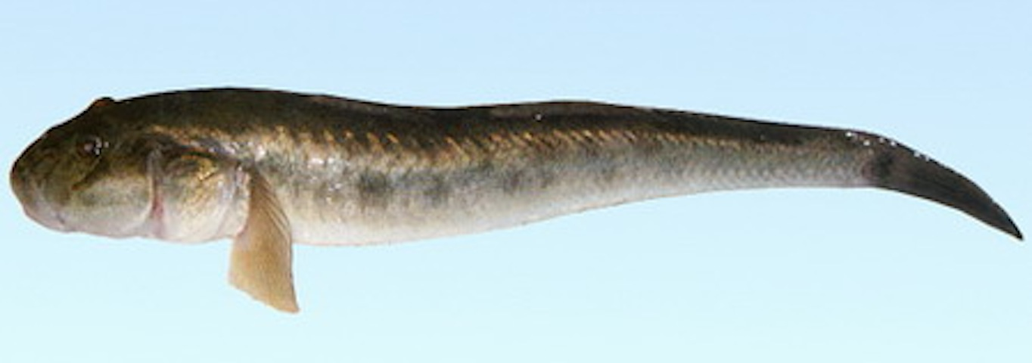
Gobioidei
Odontobutis potamophila 河川沙塘鳢 (sleepers)；
Rhinogobius giurinus 子陵吻虾虎；
Acanthogobius ommaturus 斑尾刺虾虎鱼

Slide 15


Slide 16
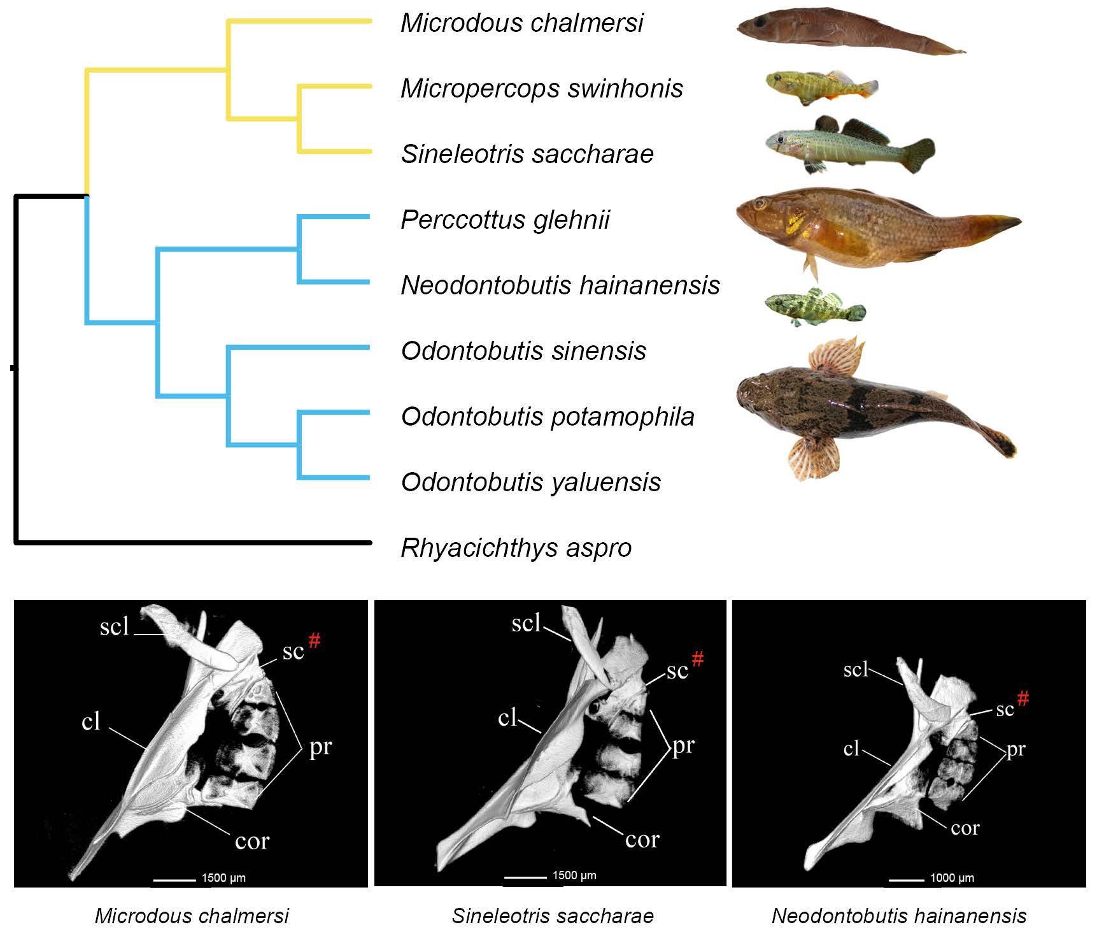

Slide 17

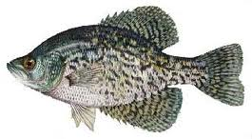
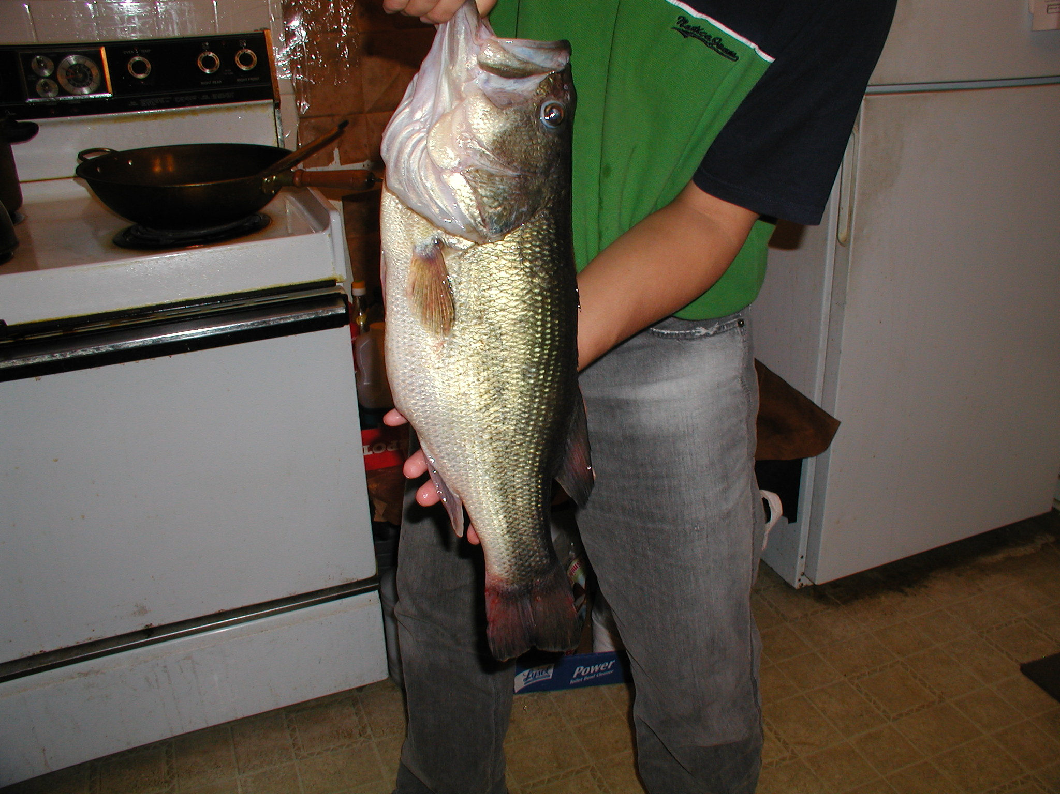
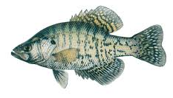
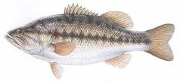
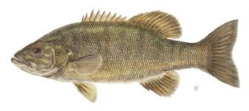
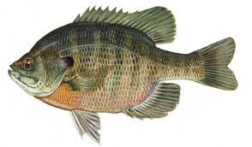
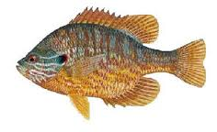
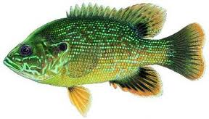
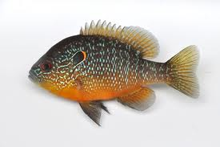
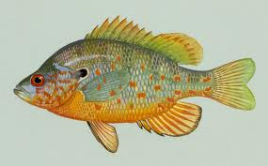
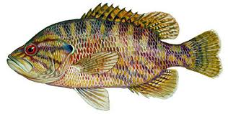
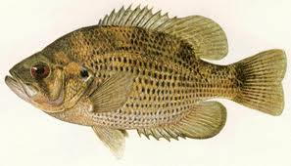
Family Centrarchidae
(sunfishes and black basses)
-One of the most widely distributed, widely known families in North America
-29 species; all native to North America west of the
Rocky Mountains except the Sacramento Perch
-Deep-bodied; very maneuverable (via pectoral fins)
-Elaborate mating behaviors
-11 species in Wisconsin:
black crappie, white crappie, largemouth bass, smallmouth bass, bluegill, pumpkinseed, green sunfish, longear sunfish, orangespotted sunfish, warmouth, rock bass

Slide 18
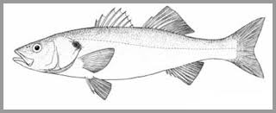
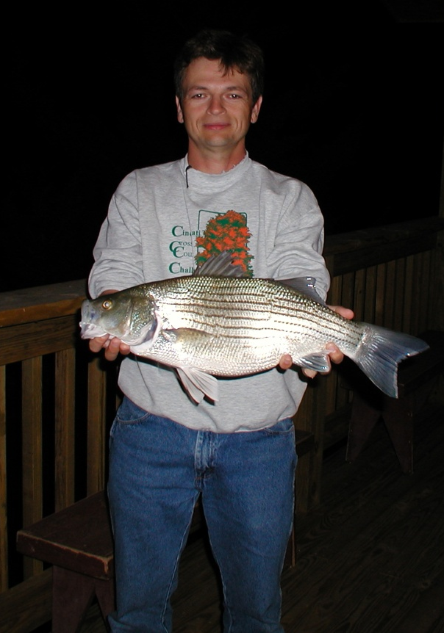
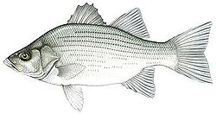
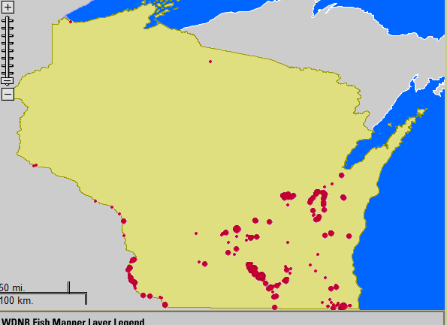
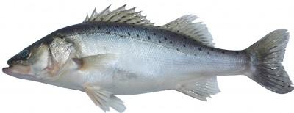
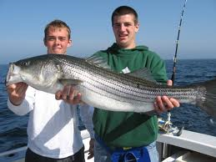
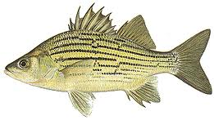
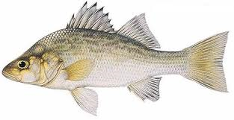
Family Moronidae
(temperate basses)
-Popular game fish in North America
-Characterized by spiny dorsal fin divided into two separate sections
- 4-6 species, depending on who you ask
-white bass
-yellow bass
-striped bass
-white perch
What is a “wiper” or “meanmouth?”

